Slide 1

CAT-III
BBS01T1002
Semi-conductor Physics
Semester: 2 Section:24
Session 2021-2022
Group No. 01 To:
Prepared by: Abhinav Kumar Choudhary(21SCSE1011615) Dr. Sanjeev Kumar

Slide 2


School of Computing Science & Engineering
Course Code : BBS01T1002
Course Name: Semiconductor physics
Fermi Dirac Distribution and Fermi Level
Course Code : XXXXXX Course Name: Data structures using C
Some basic concepts:
Fermi level :- This is the term used to describe the top of the collection of electron energy levels at absolute zero temperature.
Fermi energy:-This is the maximum energy that an electron can have in conductor at OK. It is given by
where is the velocity of electron at Fermi level.
Group No: 01 Program Name: B.Tech Sem: 02

Slide 3
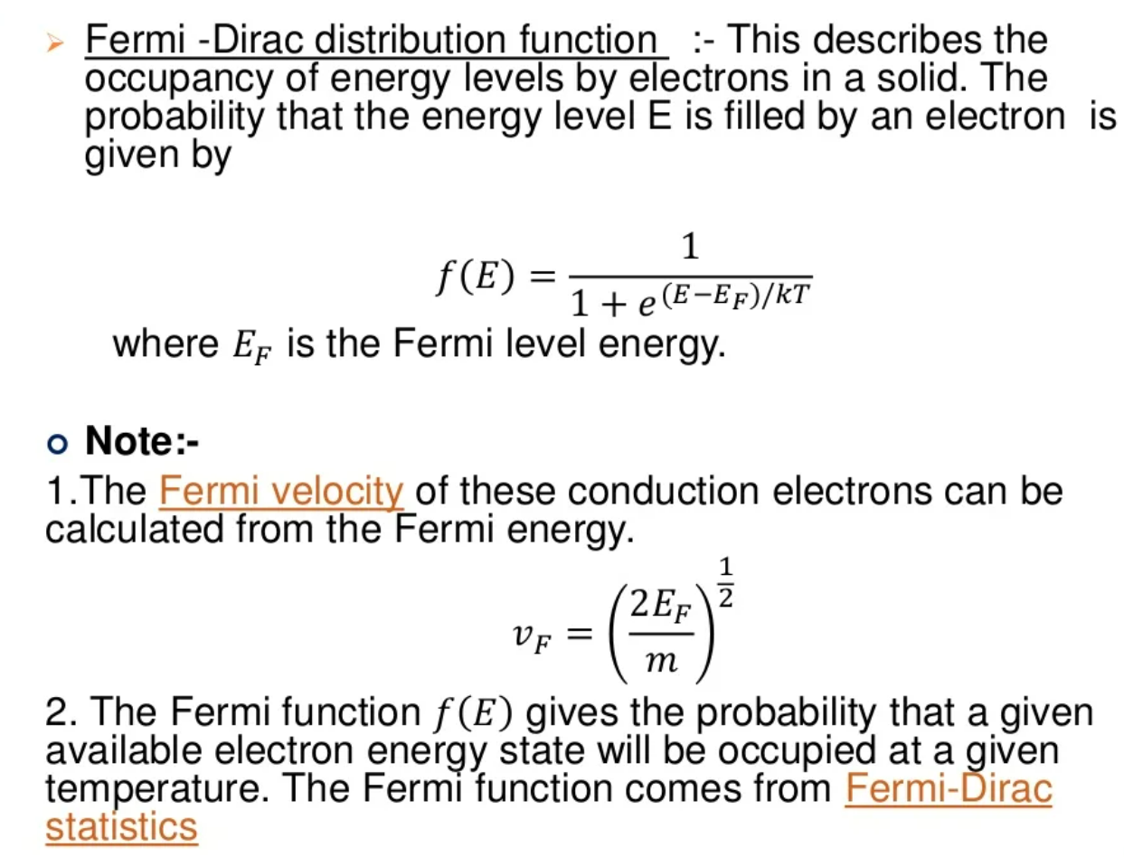
School of Computing Science & Engineering
Course Code : BBS01T1002
Course Name: Semiconductor physics

Slide 4
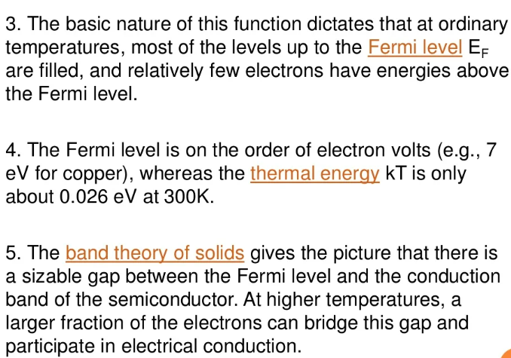
School of Computing Science & Engineering
Course Code : BBS01T1002
Course Name: Semiconductor physics

Slide 5
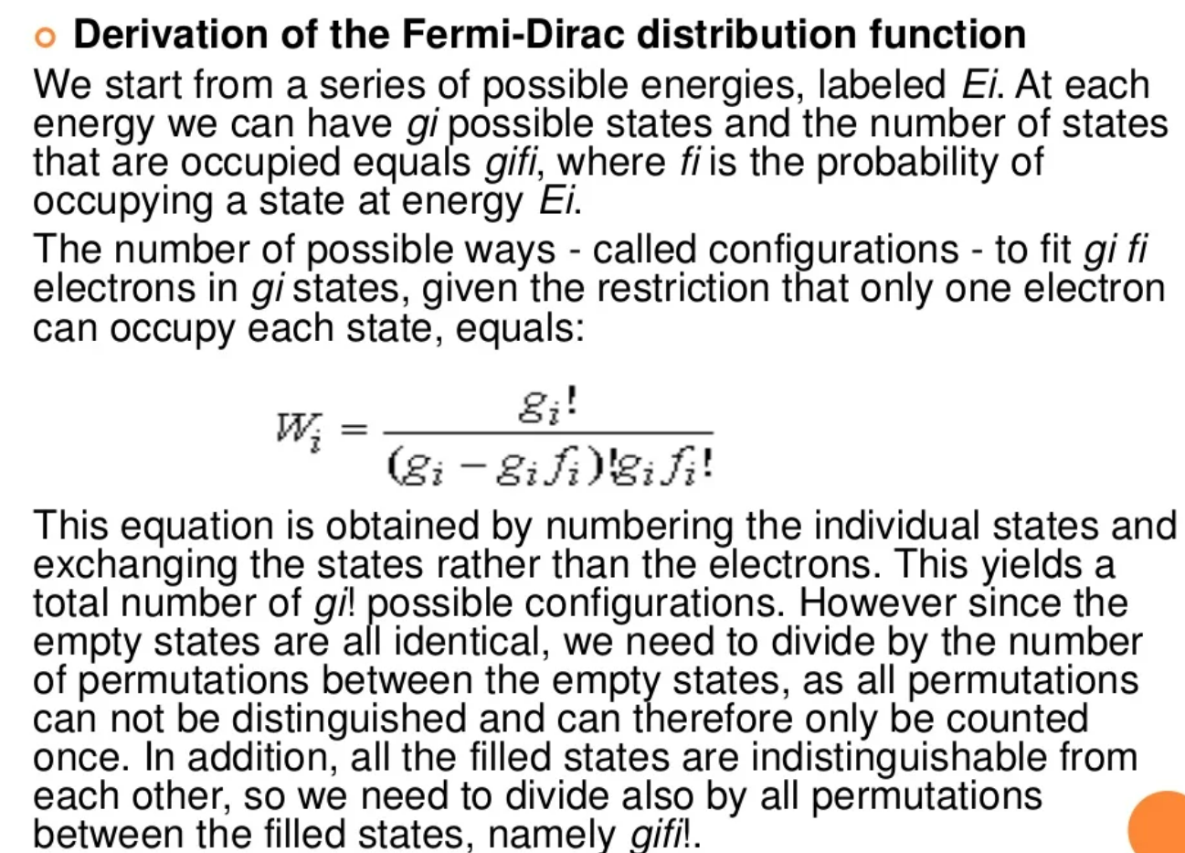
School of Computing Science & Engineering
Course Code : BBS01T1002
Course Name: Semiconductor physics

Slide 6
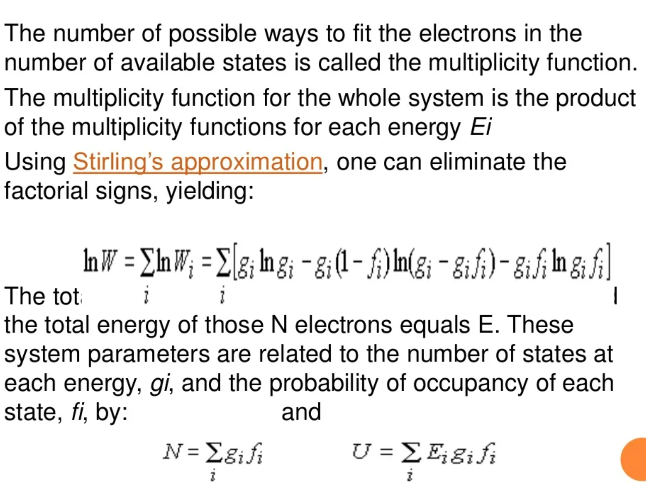
School of Computing Science & Engineering
Course Code : BBS01T1002
Course Name: Semiconductor physics

Slide 7
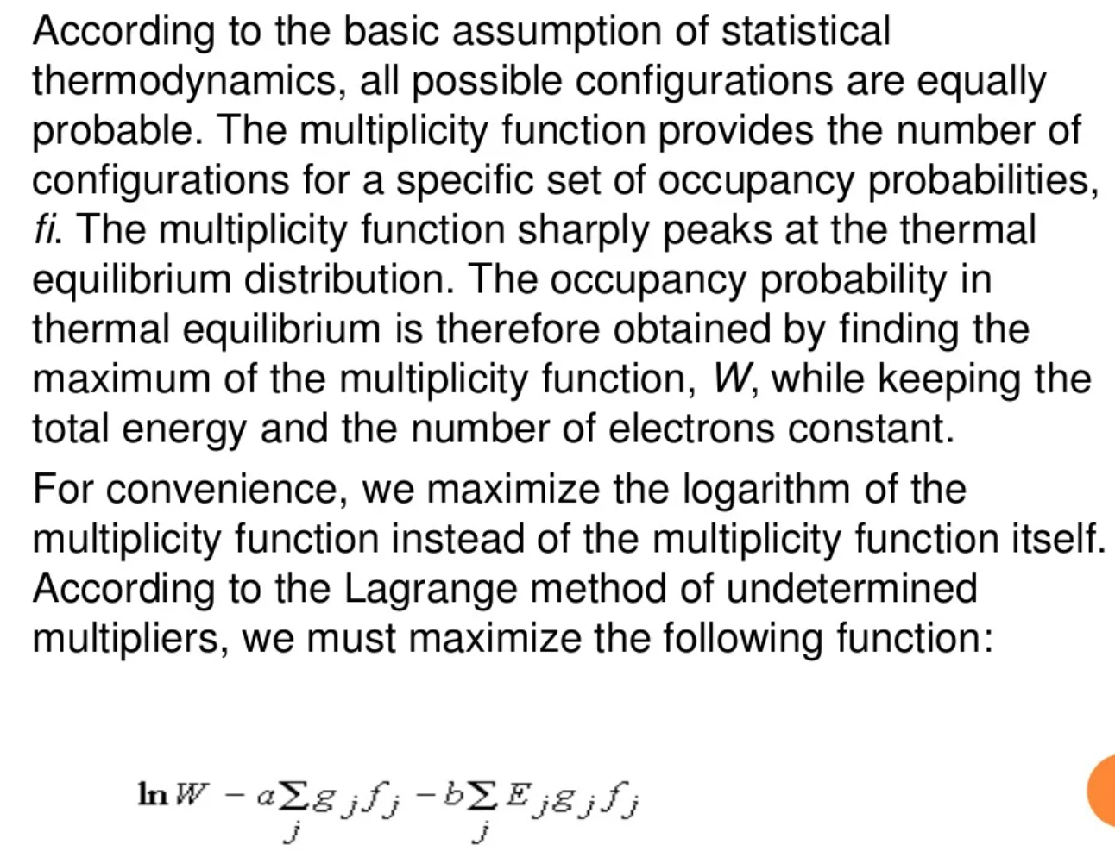
School of Computing Science & Engineering
Course Code : BBS01T1002
Course Name: Semiconductor physics

Slide 8
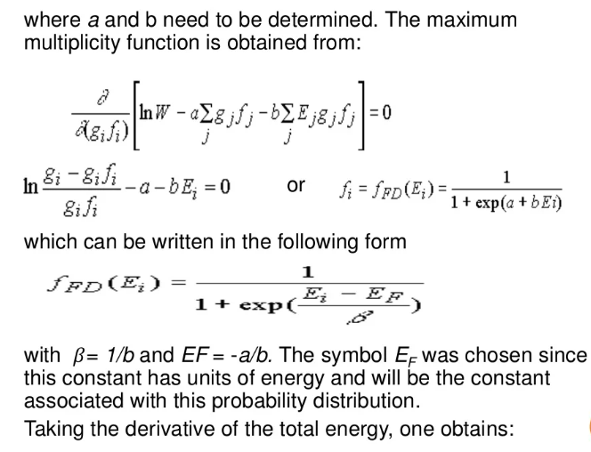
School of Computing Science & Engineering
Course Code : BBS01T1002
Course Name: Semiconductor physics

Slide 9
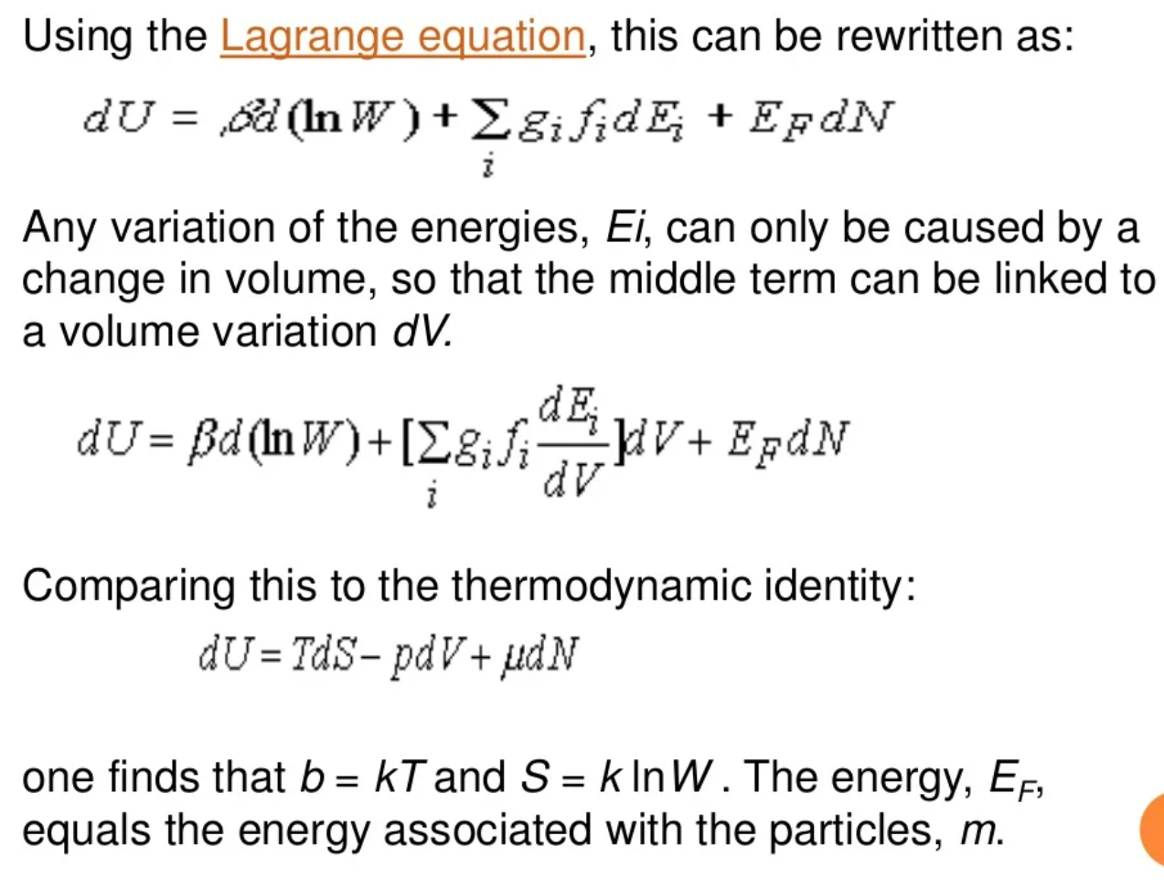
School of Computing Science & Engineering
Course Code : BBS01T1002
Course Name: Semiconductor physics

Slide 10
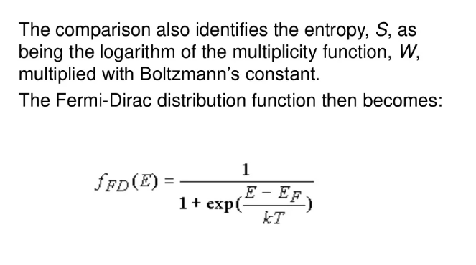
School of Computing Science & Engineering
Course Code : BBS01T1002
Course Name: Semiconductor physics

Slide 11


